Slide 1
Instruction Set of 8086
Dr. Manju Khurana
Assistant Professor, CSED
TIET, Patiala
manju.khurana@thapar.edu

Slide 2
Instruction Set of 8086
An instruction is a binary pattern designed inside a microprocessor to perform a specific function.
The entire group of instructions that a microprocessor supports is called Instruction Set.
8086 has more than 20,000 instructions.

Slide 3
Classification of Instruction Set
Data Transfer Instructions
Arithmetic Instructions
Bit Manipulation Instructions
Program Execution Transfer Instructions
String Instructions
Processor Control Instructions

Slide 4
Data Transfer Instructions
These instructions are used to transfer data from source to destination.
The operand can be a constant, memory location, register or I/O port address.

Slide 5
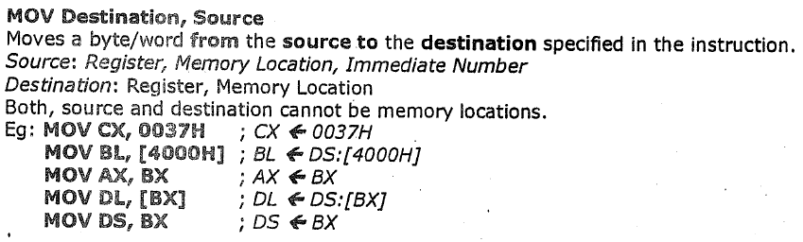
Data Transfer Instructions
MOV Des, Src:

Slide 6
Data Transfer Instructions
PUSH Operand:
It pushes the operand into top of stack.
E.g.: PUSH BX
POP Des:
It pops the operand from top of stack to Des.
Des can be a general purpose register, segment register (except CS) or memory location.
E.g.: POP AX

Slide 7
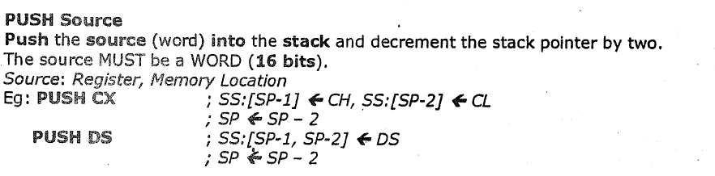
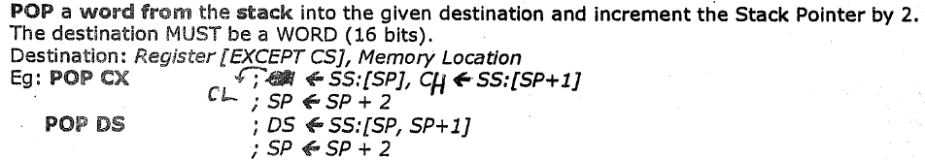
Data Transfer Instructions

Slide 8
Data Transfer Instructions
Note :- MOV, PUSH, POP are the only instructions that use the Segment Registers as operands except CS.

Slide 9
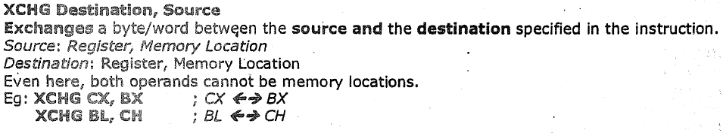
Data Transfer Instructions
XCHG Des, Src:
This instruction exchanges Src with Des.
It cannot exchange two memory locations directly.
E.g.: XCHG DX, AX
XCHG BL,CH

Slide 10
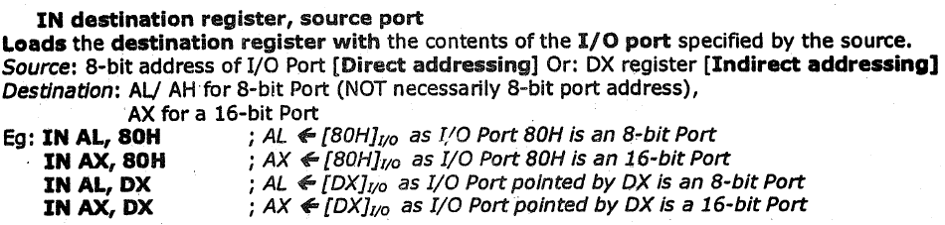
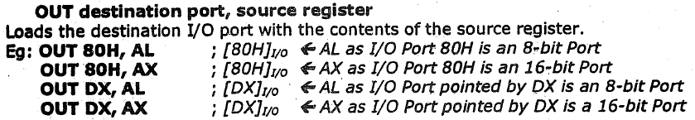
Data Transfer Instructions
IN Accumulator, Port Address:
OUT Port Address, Accumulator:

Slide 11
Data Transfer Instructions
LEA Register, Src:

Slide 12
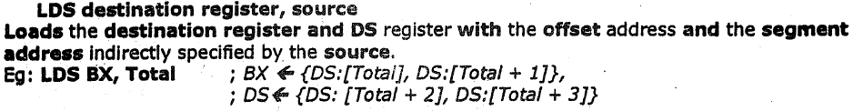
Data Transfer Instructions
LDS Des, Src:

Slide 13
Data Transfer Instructions
LDS Des, Src:
This instruction loads new values into the specified register and into the DS register from four successive memory locations.
The word from two memory locations is copied into the specified register and the word from the next two memory locations is copied into the DS registers.
LDS does not affect any flag.

Slide 14
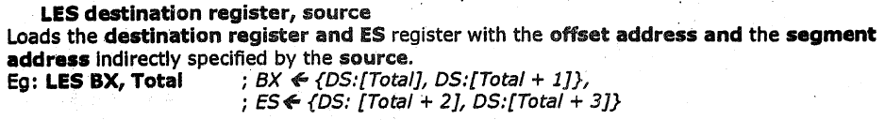
Data Transfer Instructions
LES Des, Src:
It loads 32-bit pointer from memory source to destination register and ES.
The offset is placed in the destination register and the segment is placed in ES.
This instruction is very similar to LDS except that it initializes ES instead of DS.
E.g.: same as LDS (except segment is placed in ES.)

Slide 15
Data Transfer Instructions
LAHF:
It copies the lower byte of flag register to AH.
SAHF:
It copies the contents of AH to lower byte of flag register.
PUSHF:
Pushes flag register to top of stack.
POPF:
Pops the stack top to flag register.

Slide 16
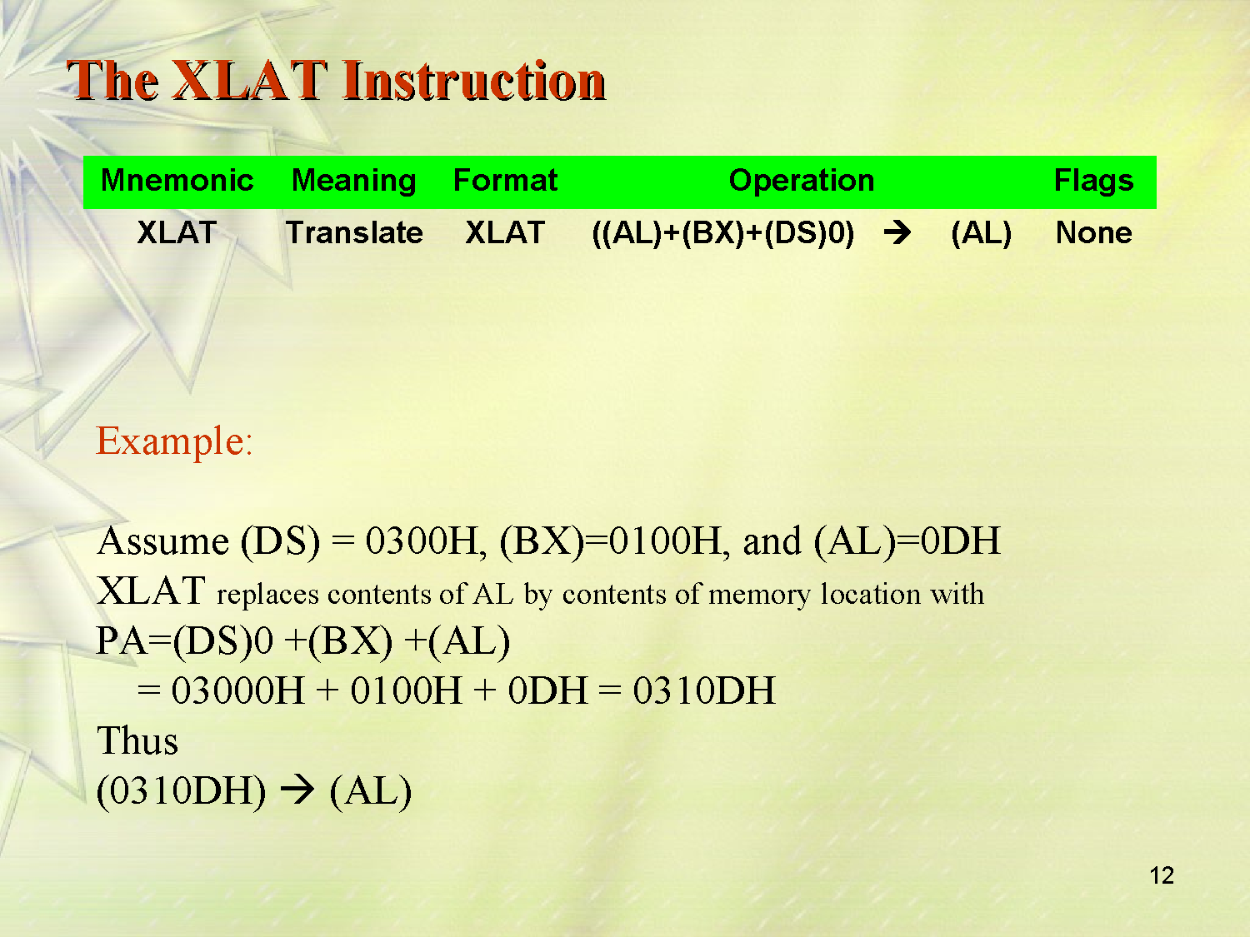

Slide 17

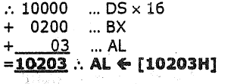
XLAT
Moves into AL, Content of mem. Loc. In DS.
whose EA is formed by sum of BX and AL.

Slide 18


Slide 19
Instruction Set of 8086
Dr. Manju Khurana
Assistant Professor, CSED
TIET, Patiala
manju.khurana@thapar.edu

Slide 20
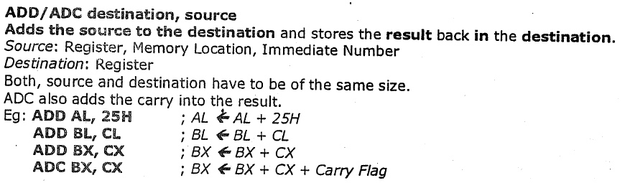
Arithmetic Instructions
ADD Des, Src:
It adds a byte to byte or a word to word.
It effects AF, CF, OF, PF, SF, ZF flags.

Slide 21
Arithmetic Instructions
ADC Des, Src:
It adds the two operands with CF.
It effects AF, CF, OF, PF, SF, ZF flags.
E.g.:
ADC AL, 74H
ADC DX, AX
ADC AX, [BX]

Slide 22
Arithmetic Instructions
SUB Des, Src:
It subtracts a byte from byte or a word from word.
It effects AF, CF, OF, PF, SF, ZF flags.
For subtraction, CF acts as borrow flag.
E.g.:
SUB AL, 74H
SUB DX, AX
SUB AX, [BX]

Slide 23
Arithmetic Instructions
SBB Des, Src:
It subtracts the two operands and also the borrow from the result.
It effects AF, CF, OF, PF, SF, ZF flags.
E.g.:
SBB AL, 74H
SBB DX, AX
SBB AX, [BX]

Slide 24
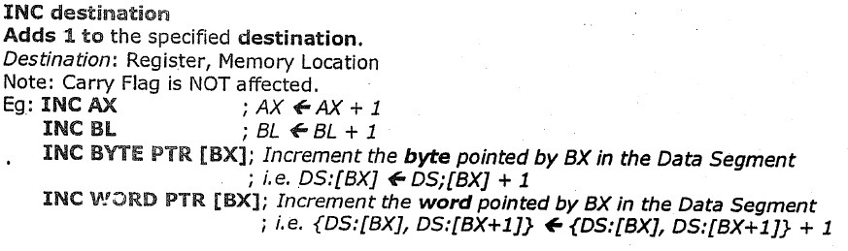
Arithmetic Instructions
INC Src:
It increments the byte or word by one.
The operand can be a register or memory location.
It effects AF, OF, PF, SF, ZF flags.
CF is not effected.

Slide 25
Arithmetic Instructions
DEC Src:
It decrements the byte or word by one.
The operand can be a register or memory location.
It effects AF, OF, PF, SF, ZF flags.
CF is not effected.
E.g.: DEC AX

Slide 26
Arithmetic Instructions
MUL Src:
It is an unsigned multiplication instruction.
It multiplies two bytes to produce a word or two words to produce a double word.
AX = AL * Src
DX : AX = AX * Src
This instruction assumes one of the operand in AL or AX.
Src can be a register or memory location.
IMUL Src:
It is a signed multiplication instruction.

Slide 27
Arithmetic Instructions
MUL – MUL Source
This instruction multiplies an unsigned byte in some source with an unsigned byte in AL register or an unsigned word in some source with an unsigned word in AX register.
The source can be a register or a memory location. When a byte is multiplied by the content of AL, the result (product) is put in AX. When a word is multiplied by the content of AX, the result is put in DX and AX registers.
If the most significant byte of a 16-bit result or the most significant word of a 32-bit result is 0, CF and OF will both be 0’s. AF, PF, SF and ZF are undefined after a MUL instruction.

Slide 28
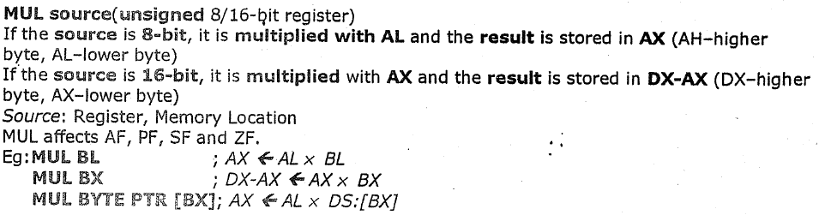
Arithmetic Instructions
MUL – MUL Source
If you want to multiply a byte with a word, you must first move the byte to a word location such as an extended register and fill the upper byte of the word with all 0’s.
You cannot use the CBW instruction for this, because the CBW instruction fills the upper byte with copies of the most significant bit of the lower byte.

Slide 29
Arithmetic Instructions
IMUL – IMUL Source
multiplies a signed byte from source with a signed byte in AL or a signed word from some source with a signed word in AX.
If the magnitude of the product does not require all the bits of the destination, the unused byte / word will be filled with copies of the sign bit.
CF,OF --???:- If the upper byte of a 16-bit result or the upper word of a 32-bit result contains only copies of the sign bit (all 0’s or all 1’s), then CF and the OF will both be 0;
If it contains a part of the product, CF and OF will both be 1.
AF, PF, SF and ZF are undefined after IMUL.

Slide 30
Arithmetic Instructions
IMUL – IMUL Source
If you want to multiply a signed byte with a signed word, you must first move the byte into a word location and fill the upper byte of the word with copies of the sign bit.
If you move the byte into AL, you can use the CBW instruction to do this.

Slide 31
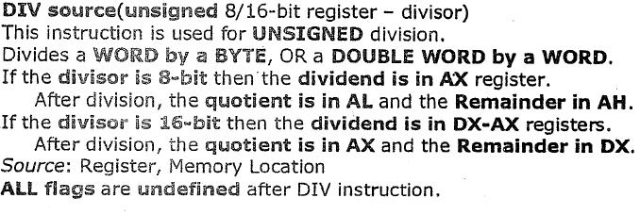
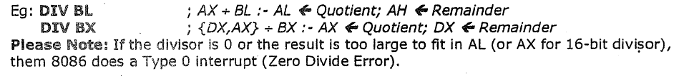
Arithmetic Instructions
DIV Src:
It is an unsigned division instruction.
To divide an unsigned word by a byte or to divide an unsigned double word (32 bits) by a word. The operand is stored in AX, divisor is Src and the result is stored as:
AH = remainder AL = quotient

Slide 32
Arithmetic Instructions
DIV – DIV Source
When a word is divided by a byte, the word must be in the AX register. The divisor can be in a register or a memory location.
When a double word is divided by a word, the most significant word of the double word must be in DX, and the least significant word of the double word must be in AX. After the division, AX will contain the 16-bit quotient and DX will contain the 16-bit remainder.

Slide 33
Arithmetic Instructions
DIV – DIV Source
If an attempt is made to divide by 0 or if the quotient is too large to fit in the destination (greater than FFH / FFFFH), the 8086 will generate a type 0 interrupt. All flags are undefined after a DIV instruction.

Slide 34
Arithmetic Instructions
DIV – DIV Source
If you want to divide a byte by a byte, you must first put the dividend byte in AL and fill AH with all 0’s.
Likewise, if you want to divide a word by another word, then put the dividend word in AX and fill DX with all 0’s.

Slide 35
Arithmetic Instructions
IDIV – IDIV Source
This instruction is used to divide a signed word by a signed byte, or to divide a signed double word by a signed word.
When dividing a signed word by a signed byte, the word must be in the AX register.

Slide 36
Arithmetic Instructions
IDIV – IDIV Source
When dividing a signed word by a signed byte, the word must be in the AX register. The divisor can be in an 8-bit register or a memory location.
After the division, AL will contain the signed quotient, and AH will contain the signed remainder.
The sign of the remainder will be the same as the sign of the dividend. If an attempt is made to divide by 0, the quotient is greater than 127 (7FH) or less than –127 (81H), the 8086 will automatically generate a type 0 interrupt.

Slide 37
Arithmetic Instructions
IDIV – IDIV Source
If you want to divide a signed byte by a signed byte, you must first put the dividend byte in AL and sign-extend AL into AH.
The CBW instruction can be used for this purpose.
Likewise, if you want to divide a signed word by a signed word, you must put the dividend word in AX and extend the sign of AX to all the bits of DX.
The CWD instruction can be used for this purpose.

Slide 38
Arithmetic Instructions
IDIV – IDIV Source
When dividing a signed double word by a signed word, the most significant word of the dividend (numerator) must be in the DX register, and the least significant word of the dividend must be in the AX register.

Slide 39
Arithmetic Instructions
IDIV – IDIV Source
The divisor can be in any other 16-bit register or memory location.
After the division, AX will contain a signed 16-bit quotient, and DX will contain a signed 16-bit remainder. The sign of the remainder will be the same as the sign of the dividend.
Again, if an attempt is made to divide by 0, the quotient is greater than +32,767 (7FFFH) or less than –32,767 (8001H), the 8086 will automatically generate a type 0 interrupt.
All flags are undefined after an IDIV.

Slide 40
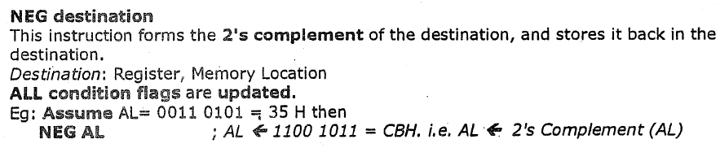
Arithmetic Instructions
NEG Src:
It creates 2’s complement of a given number.
That means, it changes the sign of a number.

Slide 41
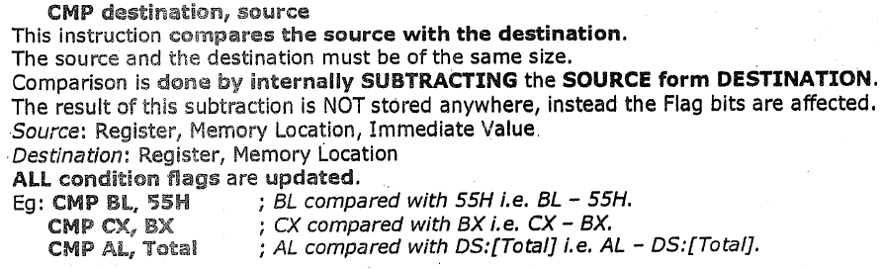
Arithmetic Instructions
CMP Des, Src:
It compares two specified bytes or words.
The Src and Des can be a constant, register or memory location.
Both operands cannot be a memory location at the same time.
The comparison is done simply by internally subtracting the source from destination.
The value of source and destination does not change, but the flags are modified to indicate the result.

Slide 42
Arithmetic Instructions
CBW (Convert Byte to Word):
This instruction converts byte in AL to word in AX.
The conversion is done by extending the sign bit of AL throughout AH.
CWD (Convert Word to Double Word):
This instruction converts word in AX to double word in DX : AX.
The conversion is done by extending the sign bit of AX throughout DX.

Slide 43
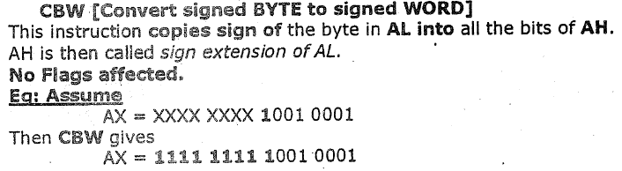
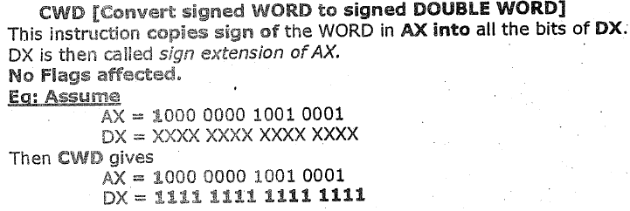
CBW
CWD

Slide 45
Instruction Set of 8086
Dr. Manju Khurana
Assistant Professor, CSED
TIET, Patiala
manju.khurana@thapar.edu

Slide 46
DAA (Decimal Adjust for Addition)
The daa instruction works as follows:
If the least significant four bits in AL are > 9 or if AF =1, it adds 06H to AL and sets AF.
If the most significant four bits in AL are > 9 or if CF =1, it adds 60H to AL and sets CF.
Example:
mov add daa
AL,71H AL,43H
; AL := B4H
; AL := 14H and CF := 1
The result including the carry (i.e., 114H) is the correct answer

Slide 47
DAS (Decimal Adjust for Subtraction)
Packed BCD subtraction
The das instruction works as follows:
If the least significant four bits in AL are > 9 or if AF =1, it subtracts 6 from AL and sets AF.
If the most significant four bits in AL are > 9 or if CF =1, it subtracts 60H from AL and sets CF.
Example:
mov sub das
AL,71H AL,43H
; AL := 2EH
; AL := 28H

Slide 48
Representation of Numbers
ASCII representation
Numbers are stored as a string of ASCII characters
» Example: 1234 is stored as 31 32 33 34H
>ASCII for 1 is 31H, for 2 is 32H, etc.
BCD representation
Unpacked BCD
» Example: 1234 is stored as 01 02 03 04H
Additional byte is used for sign
>Sign byte: 00H for + and 80H for −
Packed BCD
» Saves space by packing two digits into a byte
Example: 1234 is stored as 12 34H

Slide 49
AAA (ASCII Adjust After Addition)
If lower nibble of AL > 9 or AF = 1,then AL<- AL+6.
AH <- AH+1 Set AF - 1, CY- 1.
else
AF and CY <- Reset i.e. 0.
In both cases, Clear the higher nibble of AL.
eg.
MOV AX,0F ;
AAA;
HLT

Slide 50
AAA (ASCII Adjust After Addition)contd.
If lower nibble of AL > 9 or AF = 1,then AL<- AL+6.
AH <- AH+1 Set AF - 1, CY- 1.
else
AF and CY <- Reset i.e. 0.
In both cases, Clear the higher nibble of AL.
eg.
MOV AX,0F ; AX<- 000F, AH<- 00, AL <- 0F
AAA; AL<- F(15) + 6 = 05(21) , AH <- AH+1, ->01 AF and CY <- 1. 0105H
HLT

Slide 51
AAA (ASCII Adjust After Addition)contd.
The aaa instruction works as follows:
If the least significant four bits in AL are > 9 or if AF =1, it adds 6 to AL and 1 to AH.
– Both CF and AF are set
In all cases, the most significant four bits in AL are cleared
Example:
sub mov | AH,AH AL,'6' | ; ; | AL :=
add | AL,'7' | ; | AL :=
aaa |  | ; | AX :=
or | AL,30H | ; | AL :=

Slide 52
AAA (ASCII Adjust After Addition)contd.
The aaa instruction works as follows:
If the least significant four bits in AL are > 9 or if AF =1, it adds 6 to AL and 1 to AH.
– Both CF and AF are set
In all cases, the most significant four bits in AL are cleared
Example:
sub mov | AH,AH AL,'6' | ; ; | clear AL := | AH 36H
add | AL,'7' | ; | AL := | 36H+37H = 6DH (D+6=3,AH=0(CLEARED IN STEP 1)
aaa |  | ; | AX := | 0103H
or | AL,30H | ; | AL := | 33H

Slide 53
AAS (ASCII Adjust After Subtraction)
ASCII subtraction
The aas instruction works as follows:
If the least significant four bits in AL are > 9 or if AF =1, it subtracts 6 from AL and 1 from AH.
– Both CF and AF are set
In all cases, the most significant four bits in AL are cleared
This adjustment is needed only if the result is negative

Slide 54
AAS (ASCII Adjust After Subtraction)contd.
ASCII subtraction
If lower nibble of AL > 9 or AF = 1,then AL<- AL-6.
AH <- AH-1 Set AF - 1, CY- 1.
else
AF and CY <- Reset i.e. 0.
In both cases, Clear the higher nibble of AL.
eg.
MOV AX,020FH ;
AAS;
HLT

Slide 55
AAS (ASCII Adjust After Subtraction)contd.
ASCII subtraction
If lower nibble of AL > 9 or AF = 1,then AL<- AL-6.
AH <- AH-1 Set AF - 1, CY- 1.
else
AF and CY <- Reset i.e. 0.
In both cases, Clear the higher nibble of AL.
eg.
MOV AX,020FH ; AX<- 020F, AH<- 02, AL <- 0F
AAS; AL<- F(15) - 6 = 09 , AH <- AH-1, ->01 AF and CY <- 1. 0109 ANS
HLT

Slide 56
AAS (ASCII Adjust After Subtraction)contd.
Example 1: Positive result
sub mov | AH,AH AL,'9' | ; ;
sub | AL,'3' | ;
aas |  | ;
or | AL,30H | ;
Example 2: Negative result
sub AH,AH ;
mov | AL,'3' | ;
sub | AL,'9' | ;
aas |  | ;
or | AL,30H | ;

Slide 57
AAS (ASCII Adjust After Subtraction)contd.
Example 1: Positive result
sub mov | AH,AH AL,'9' | ; ; | clear AL := | AH 39H
sub | AL,'3' | ; | AL := | 39H-33H = 6H
aas |  | ; | AX := | 0006H
or | AL,30H | ; | AL := | 36H
Example 2: Negative result
sub AH,AH ; clear AH
mov | AL,'3' | ; | AL | := | 33H
sub | AL,'9' | ; | AL | := | 33H-39H = FAH(2’ OF -6)
aas |  | ; | AX | := | FF04H
or | AL,30H | ; | AL | := | 34H

Slide 58
AAM (ASCII Adjust After Multiplication)
ASCII multiplication
The aam instruction adjusts the result of a mul instruction
Multiplication should not be performed on ASCII
» Can be done on unpacked BCD
The aam instruction works as follows
AL is divided by 10
Quotient is stored in AH
Remainder in AL
aam does not work with imul instruction

Slide 59
AAM (ASCII Adjust After Multiplication)contd.
ASCII multiplication
eg.
MOV AL,5H
MOV BL,7H
MUL BL
AAM
HLT

Slide 60
AAM (ASCII Adjust After Multiplication)contd.
ASCII multiplication
eg.
MOV AL,5H
MOV BL,7H
MUL BL 5*7 = 23H (35)-----(35/16 = 2(Q), 3(R)) Result will go in AX(16 bit)
AAM 35/10 = 3(Q), 5(R) , AH<- 03 AL <- 05
HLT

Slide 61
AAM (ASCII Adjust After Multiplication)contd.
Example 1 mov AL,3 mov BL,9 |  | ; ;
mul BL |  | ;
aam |  | ;
or AX,3030H |  | ;
Example 2
mov | AL,'3' | ;
mov | BL,'9' | ;
and | AL,0FH | ;
and | BL,0FH | ;
mul aam or | BL AL,30H | ; ; ;

Slide 62
AAM (ASCII Adjust After Multiplication)contd.
Example 1 mov AL,3 mov BL,9 |  | ; ; | multiplier in unpacked BCD form multiplicand in unpacked BCD form
mul BL |  | ; | result 001BH is in AX
aam |  | ; | AX := 0207H
or AX,3030H |  | ; | AX := 3237H
Example 2
mov | AL,'3' | ; | multiplier in ASCII
mov | BL,'9' | ; | multiplicand in ASCII
and | AL,0FH | ; | multiplier in unpacked BCD form
and | BL,0FH | ; | multiplicand in unpacked BCD form
mul aam or | BL AL,30H | ; ; ; | result 001BH is in AX AX := 0207H AL := 37H

Slide 63
AAD (ASCII Adjust Before Division)
The aad instruction works as follows
Multiplies AH by 10 and adds it to AL and sets AH to 0
Example:
» If AX is 0207H before AAD
» AX is changed to 001BH after AAD
AAD instruction reverses the changes done by AAM

Slide 64
AAD (ASCII Adjust Before Division)contd.
ASCII division
MOV AX,0205H ; AX<- 0205, AH<- 02, AL <- 05
AAD AL<- (AH*10)+AL= (02*10)+05 == 19(25), AH <- 00
HLT

Slide 65
AAD (ASCII Adjust Before Division)contd.
Example: Divide 27 by 5
mov mov | AX,0207H BL,05H | ; ; | dividend in unpacked BCD form divisor in unpacked BCD form
aad |  | ; | AX := 001BH
div | BL | ; | AX := 0205H
AL <- 05 AH <- 02
(vice versa of AAM)
aad converts the unpacked BCD number in AX to hexadecimal form so that div can be used.

Slide 66
WAP to perform the division 15/6 using the ASCII codes. Store the ASCII codes of result in Register DX.
MOV AX, ’15’ ; AX=31 35
MOV BH, ’6’ ; BX=36 00
SUB AX,3030h ; AX=01 05
SUB BH,30H ; BH=06 00
AAD ; AX=00 0F
DIV BH ; AX=03 02
ADD AX,3030H ; AX=33 32
MOV DX,AX ; DX=33 32
HLT

Slide 68
Instruction Set of 8086
Dr. Manju Khurana
Assistant Professor, CSED
TIET, Patiala
manju.khurana@thapar.edu

Slide 69
WAP to find the largest of 8 bit numbers.
MOV CL, 0AH
LEA SI,[1000H]
MOV AL,[SI]
L1:INC SI
MOV BL,[SI]
CMP AL,BL
JC L2
JMP L3
L2: MOV AL,BL
L3: DEC CL
JNZ L1
MOV [100AH],AL
HLT
1000-23
1001-40
1002-12
1003-14
1004-20
1005-35
1006-67
1007-70
1008-90
1009-80
100A- OUTPUT

Slide 70
WAP to find the largest of 16 bit numbers.
MOV BX, 1000H ; BX=10 00
MOV CL, [BX] ; CL=00 05
INC BX ; BX=10 01
MOV AX, [BX] ; AX=30 20
DEC CL ; CL=00 04
BACK: INC BX ; BX=10 02
INC BX ; BX=10 03
CMP AX,[BX]
JNC Next
MOV AX, [BX] ; AX= 50 40 70 60 90 80
Next: DEC CL ; CL=00 03 00 02 00 01
JNZ Back
MOV [1020H],AX ; AX= 90 80
HLT
1000-05
1001-20
1002-30
1003-40
1004-50
1005-60
1006-70
1007-80
1008-90
1009-10
100A-20
1020-OUTPUT

Slide 71
WAP to find out the count of positive numbers and negative numbers from a series of signed numbers in 8086.
1000-01
1001-02
1002-03
1003-04
1004-80
1005-81
1006-82
1007-83
1008-84
1009-85
100A-04 O/P
1020-06 O/P
MOV CL, 0AH
MOV BL, 00H
MOV DL,00H
LEA SI,[1000H]
L1:MOV AL,[SI]
SHL AL,01
JNC L2
INC DL
JMP L3
L2: INC BL
L3: INC SI

Slide 72
WAP to find out the count of positive numbers and negative numbers from a series of signed numbers in 8086.
1000-01
1001-02
1002-03
1003-04
1004-80
1005-81
1006-82
1007-83
1008-84
1009-85
100A-04 O/P
1020-06 O/P
DEC CL
JNZ L1
MOV [100AH],BL
MOV [100BH],DL
HLT

Slide 73
Fibonacci Series:-
MOV SI,3000H ; SI=3000
MOV CX,0AH ; CX=00 0A
XOR AL,AL ; AL=00
MOV [SI],0AH ; [3000]=0A
INC SI ;3001
MOV [SI],00H ;[3001]=00
ADD AL,01H ; AL=01
INC SI ; 3002
MOV [SI],AL ; 3002= 01
INC SI ; 3003
MOV [SI],AL ;3003= 01
Back: ADD AL,[SI] ; 01,01 =02
INC SI ; 3004
MOV [SI],AL ; 3004=02
DEC SI ; 3003
MOV AL,[SI] ; AL=01
INC SI ; 3004
LOOP Back
HLT ; halt!

Slide 75
Bit Manipulation Instructions or Logical Instructions
Dr. Manju Khurana
Assistant Professor, CSED
TIET, Patiala
manju.khurana@thapar.edu

Slide 76
Bit Manipulation Instructions
These instructions are used at the bit level.
These instructions can be used for:
Testing a zero bit
Set or reset a bit
Shift bits across registers

Slide 77
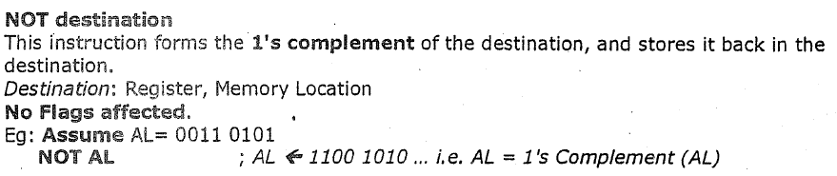
Bit Manipulation Instructions
NOT Src:
The NOT instruction inverts each bit (forms the 1’s complement) of a byte or word in the specified destination. The destination can be a register or a memory location. This instruction does not affect any flag.
NOT BX Complement content or BX register
NOT BYTE PTR [BX] Complement memory byte at offset [BX] in data segment.

Slide 78
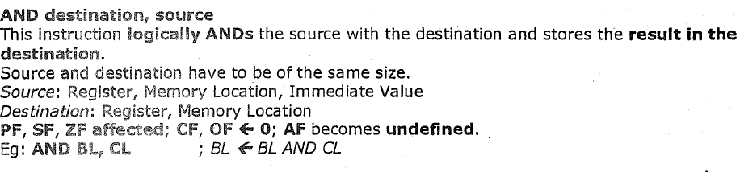
Bit Manipulation Instructions
AND Des, Src:
It performs AND operation of Des and Src.
Src can be immediate number, register or memory location.
Des can be register or memory location.
Both operands cannot be memory locations at the same time.
CF and OF become zero after the operation.
PF, SF and ZF are updated.

Slide 79
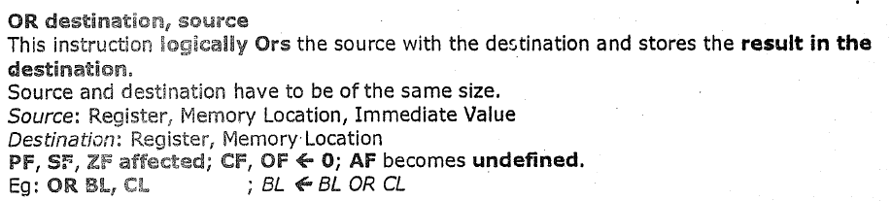
Bit Manipulation Instructions
OR Des, Src:
It performs OR operation of Des and Src.
Src can be immediate number, register or memory location.
Des can be register or memory location.
Both operands cannot be memory locations at the same time.
CF and OF become zero after the operation.
PF, SF and ZF are updated.

Slide 80
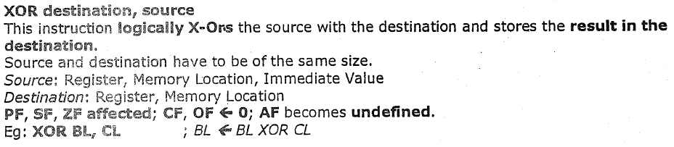
Bit Manipulation Instructions
XOR Des, Src:
It performs XOR operation of Des and Src.
Src can be immediate number, register or memory location.
Des can be register or memory location.
Both operands cannot be memory locations at the same time.
CF and OF become zero after the operation.
PF, SF and ZF are updated.

Slide 81
Bit Manipulation Instructions
NEG Destination:
This instruction replaces the number in a destination with its 2’s complement. The destination can be a register or a memory location. It gives the same result as the invert each bit and add one algorithm. The NEG instruction updates AF, AF, PF, ZF, and OF.
NEG AL Replace number in AL with its 2’s complement
NEG BX Replace number in BX with its 2’s complement
NEG BYTE PTR [BX] Replace byte at offset BX in DX with its 2’s complement
NEG WORD PTR [BP] Replace word at offset BP in SS with its 2’s complement

Slide 82
Bit Manipulation Instructions
TEST des,src:
This instruction ANDs the byte / word in the specified source with the byte / word in the specified destination.
Result is not stored anywhere.
Flags are updated, but neither operand is changed.
The test instruction is often used to set flags before a Conditional jump instruction.
The source can be an immediate number, the content of a register, or the content of a memory location. The destination can be a register or a memory location. The source and the destination cannot both be memory locations.
CF and OF are both 0’s after TEST. PF, SF and ZF will be updated to show the results of the destination.
AF is be undefined.

Slide 83
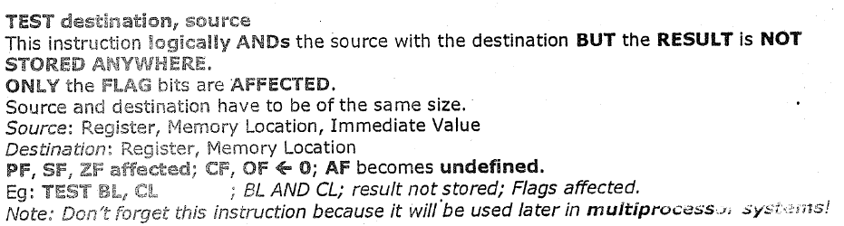
Bit Manipulation Instructions
TEST des,src:
TEST AL, BH ;AND BH with AL. No result stored; Update PF, SF, ZF.
TEST CX, 0001H ;AND CX with immediate number 0001H;
No result stored; Update PF, SF, ZF
TEST BP, [BX][DI] ;AND word are offset [BX][DI] in DS with word in BP. No result stored. Update PF, SF, and ZF

Slide 84
Bit Manipulation Instructions
SHL/SAL Des, Count: Shift Logic/Arithmatic left
It shift bits of byte or word left, by count.
It puts zero(s) in LSBs.
MSB is shifted into carry flag.
If the number of bits desired to be shifted is 1, then the immediate number 1 can be written in Count.
However, if the number of bits to be shifted is more than 1, then the count is put in CL register.

Slide 85
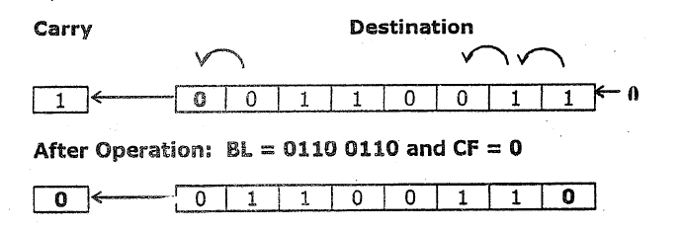
Bit Manipulation Instructions
SHL/SAL Des, Count: Shift Logic/Arithmatic left
.

Slide 86
Bit Manipulation Instructions
SHR Des, Count:
This instruction shifts each bit in the specified destination to the right.
As a bit is shifted out of the MSB position, a 0 is put in its place. The bit shifted out of the LSB position goes to CF.
In the case of multi-bit shifts, CF will contain the bit most recently shifted out from the LSB.
Bits shifted into CF previously will be lost.

Slide 87
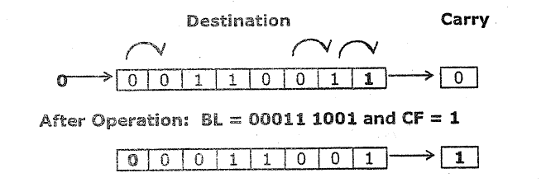
Bit Manipulation Instructions
SHR Des, Count:

Slide 88
Bit Manipulation Instructions
SHR Des, Count:
If you want to shift the operand by one bit position, you can specify this by putting a 1 in the count position of the instruction.
For shifts of more than 1 bit position, load the desired number of shifts into the CL register, and put “CL” in the count position of the instruction.

Slide 89
Bit Manipulation Instructions
SAR Des, Count:
This instruction shifts each bit in the specified destination to the right.
As a bit is shifted out of the MSB position, a copy of the old MSB is put in the MSB position. In other words, the sign bit is copied into the MSB.
The LSB will be shifted into CF. In the case of multiple-bit shift, CF will contain the bit most recently shifted out from the LSB. Bits shifted into CF previously will be lost.
MSB -🡪MSB-🡪 LSB-🡪 CF

Slide 90
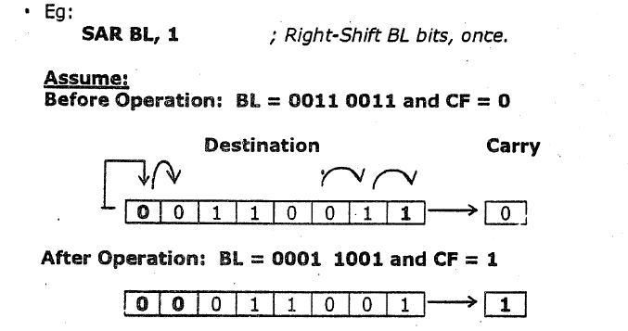
Bit Manipulation Instructions
SAR Des, Count:
SAR DX, 1 ;Shift word in DI one bit position right, new MSB = old MSB
MOV CL, 02H ;Load desired number of shifts in CL
SAR WORD PTR [BP], CL ;Shift word at offset [BP] in stack segment right by two bit positions, the two MSBs are now copies of original MSB

Slide 91
Bit Manipulation Instructions
ROL Des, Count:rotate left without carry
It rotates bits of byte or word left, by count.
MSB is transferred to LSB and also to CF.
If the number of bits desired to be shifted is 1, then the immediate number 1 can be written in Count.
However, if the number of bits to be shifted is more than 1, then the count is put in CL register.

Slide 92
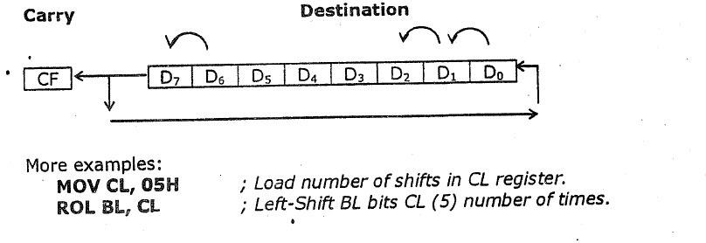
Bit Manipulation Instructions
ROL Des, Count:

Slide 93
Bit Manipulation Instructions
ROR Des, Count: rotate right without carry
It rotates bits of byte or word right, by count.
LSB is transferred to MSB and also to CF.
If the number of bits desired to be shifted is 1, then the immediate number 1 can be written in Count.
However, if the number of bits to be shifted is more than 1, then the count is put in CL register.

Slide 94
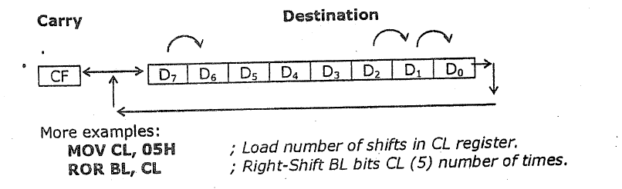
Bit Manipulation Instructions
ROR Des, Count:

Slide 95
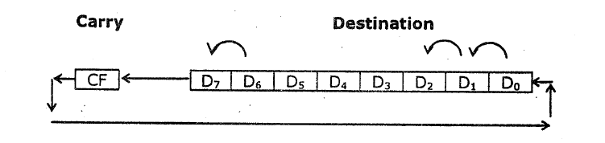
Bit Manipulation Instructions
RCL Des, Count: rotate left through carry
This instruction rotates all the bits in a specified word or byte some number of bit positions to the left.
The operation circular because the MSB of the operand is rotated into the carry flag and the bit in the carry flag is rotated around into LSB of the operand.

Slide 96
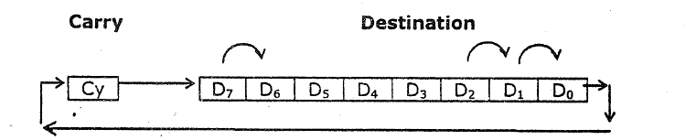
Bit Manipulation Instructions
RCR Des, Count: rotate right through carry
This instruction rotates all the bits in a specified word or byte some number of bit positions to the right.
The operation circular because the LSB of the operand is rotated into the carry flag and the bit in the carry flag is rotate around into MSB of the operand.

Slide 98
Program Execution Transfer Instructions
Dr. Manju Khurana
Assistant Professor, CSED
TIET, Patiala
manju.khurana@thapar.edu

Slide 99
Program Execution Transfer Instructions
These instructions cause change in the sequence of the execution of instruction.
This change can be through a condition or sometimes unconditional.
The conditions are represented by flags.

Slide 100
Program Execution Transfer Instructions
2 main type of branching:
Near :- Intra-segment(branch to new location within current segment only)
Only IP needs to be changed.
Range of -128 to 127 🡪 short branch.
Far:- Inter-segment(branch to new location in a different segment.)
Value of CS and IP need to be changed.

Slide 101
Program Execution Transfer Instructions
JMP Des:
Intrasegment direct jump:- new branch location is specified directly in instruction.
New address calculated by 8 bit(16 bit) displacement to the IP.
CS not change.
+ve disp.🡪 forward jump
-ve disp. 🡪 backward jump
Also called relative jump
JMP Prev(or Next), IP 🡨 offset addr. Of “Prev” or “Next”.

Slide 102
Program Execution Transfer Instructions
JMP Des:
Intrasegment indirect jump:- new branch location is specified indirectly through a reg or mem. Loc (in DS only).
Value of IP is replaced with new value.
CS not change.
JMP WORD PTR[BX];
IP🡨 {DS:[BX], DS:[BX+1]}

Slide 103
Program Execution Transfer Instructions
JMP Des:
Inter-segment(FAR) jump:- Jump add. is specified in 2 ways:-
Inter-segment Direct jump
New branch location is specified directly in the instruction.
CS & IP get new value.
Eg. JMP NextSeg; CS & IP get new value from label NextSeg.

Slide 104
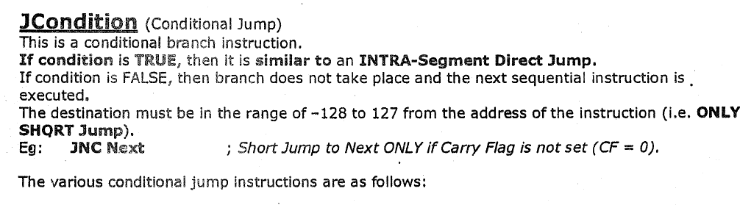
Program Execution Transfer Instructions
JMP Des:
Inter-segment(FAR) jump:- Jump add. is specified in 2 ways:-
Inter-segment indirect jump
New branch location specified indirectly through a reg. or mem. Loc.
CS & IP get new value.
Eg. JMP DWORD PTR[BX]; IP🡨 {DS:[BX],DS:[BX+1]}, CS🡨{DS:[BX+2],DS:[BX+3]}

Slide 105
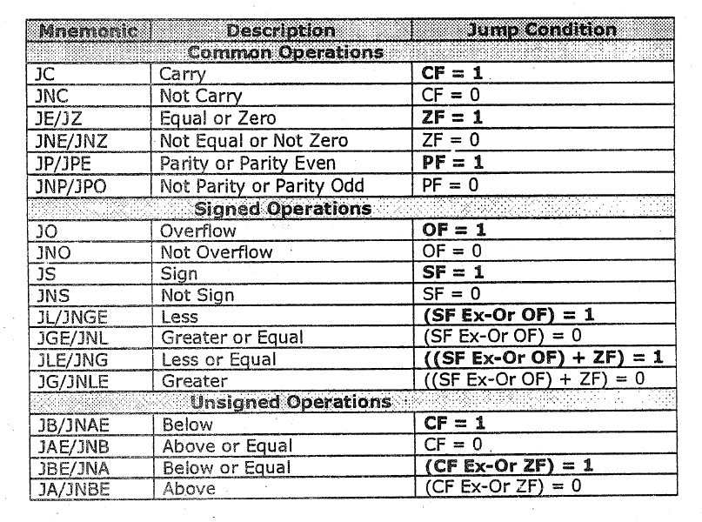
Conditional Jump Table

Slide 106
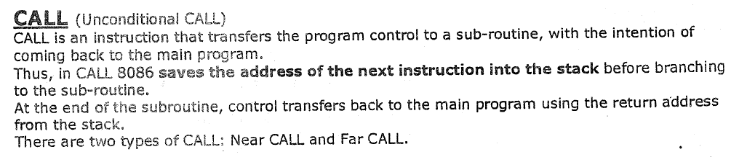
Program Execution Transfer Instructions

Slide 107
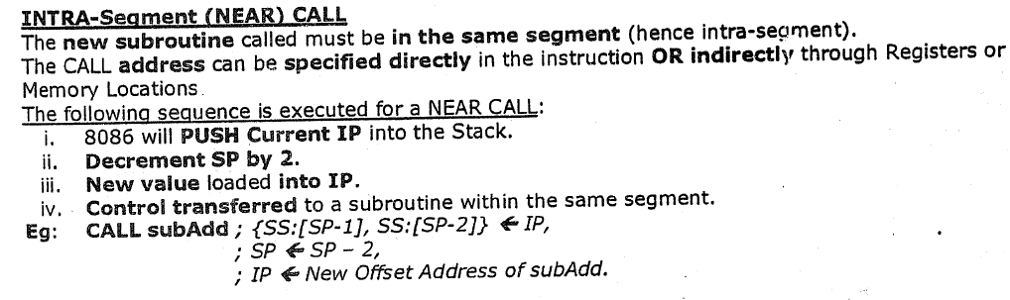
Program Execution Transfer Instructions
CALL(Unconditional): 2 types of call:- Near & Far

Slide 108
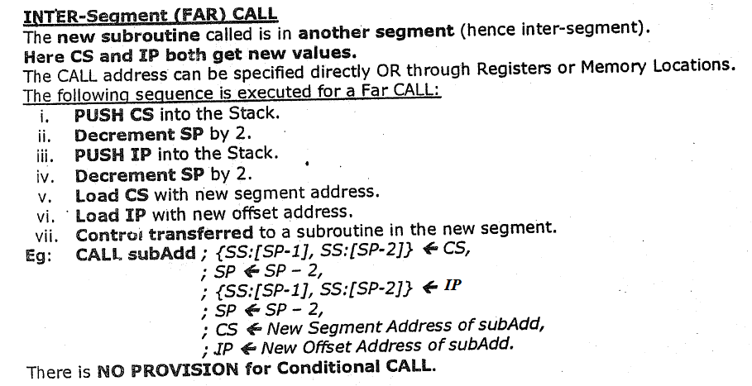
Program Execution Transfer Instructions
CALL(Unconditional): 2 types of call:- Near & Far

Slide 109
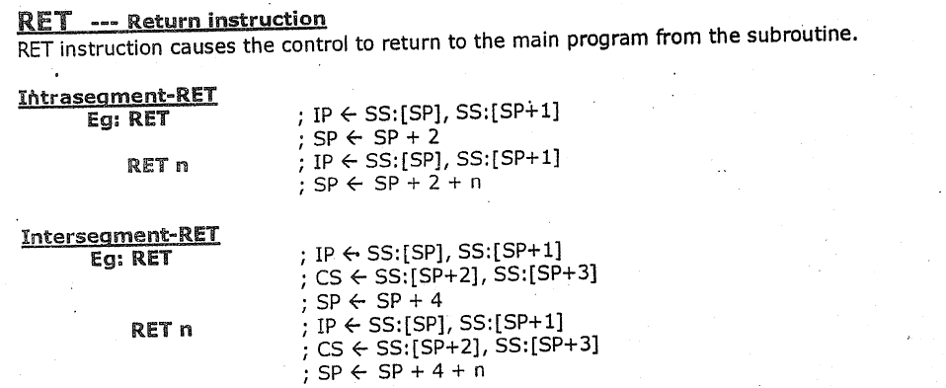
Program Execution Transfer Instructions

Slide 110
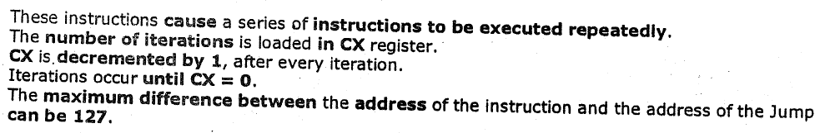
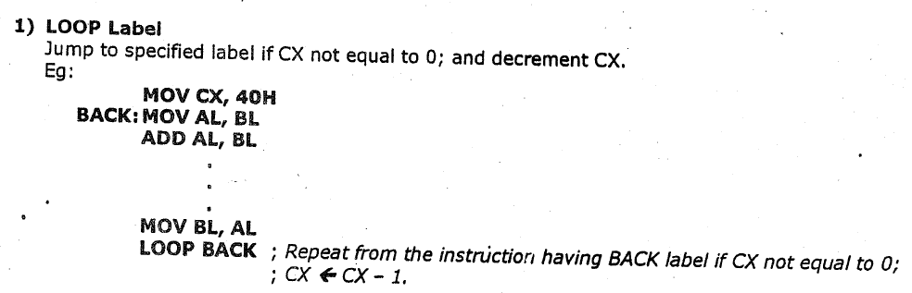
Program Execution Transfer Instructions (Iteration Control Instructions)

Slide 111
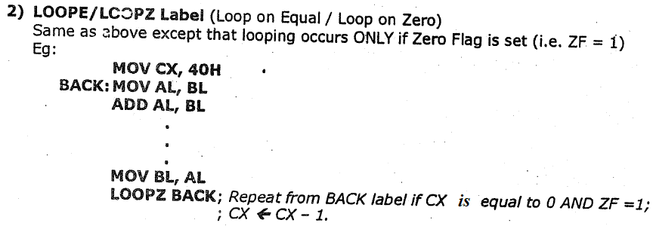
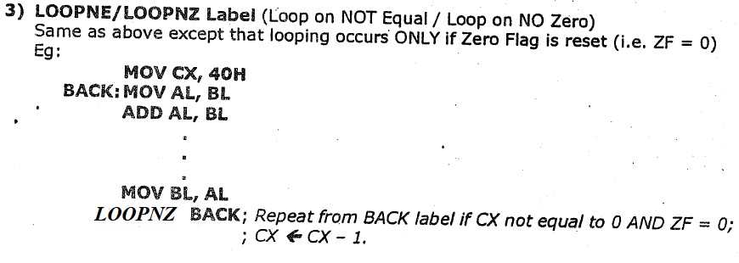
Program Execution Transfer Instructions (Iteration Control Instructions)

Slide 113
Processor Control/Machine Control Instructions
Dr. Manju Khurana
Assistant Professor, CSED
TIET, Patiala
manju.khurana@thapar.edu

Slide 114
Processor Control Instructions
These instructions control the processor itself.
8086 allows to control certain control flags that:
causes the processing in a certain direction
processor synchronization if more than one microprocessor attached.

Slide 115
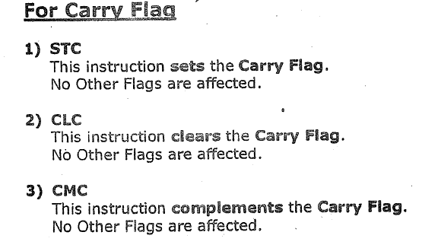
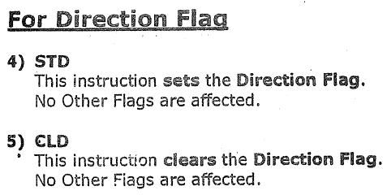
Processor Control Instructions

Slide 116
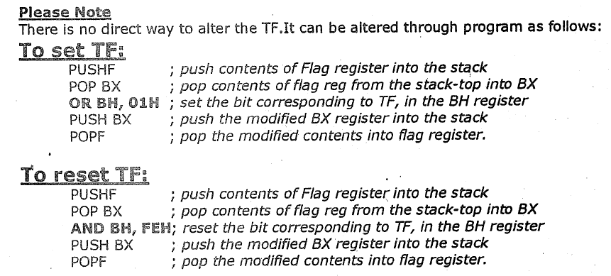
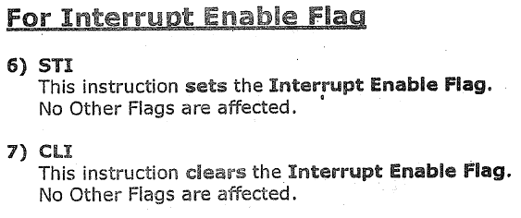
Processor Control Instructions

Slide 117
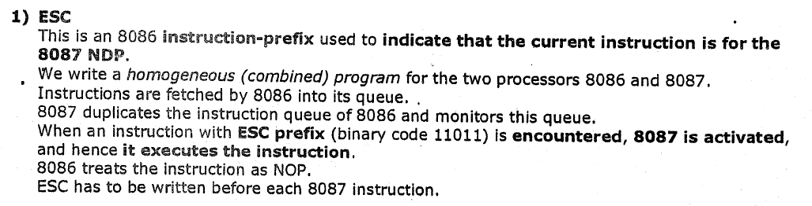
External H/w Synchronization Instructions

Slide 118
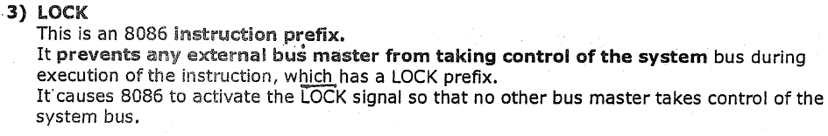
External H/w Synchronization Instructions
2) WAIT:- It is used to synchronize 8086 with co-processor 8087 via TEST(bar) I/P pin of 8086.
When 8087 is busy, it puts “1” on its BUSY O/P line connected to TEST I/P of MP.
Wait instruction Make MP to check TEST pin.

Slide 119
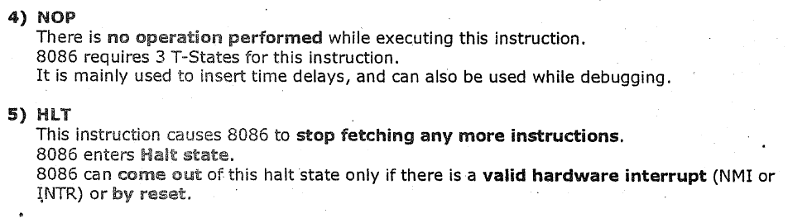
External H/w Synchronization Instructions

Slide 120
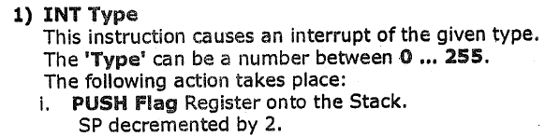
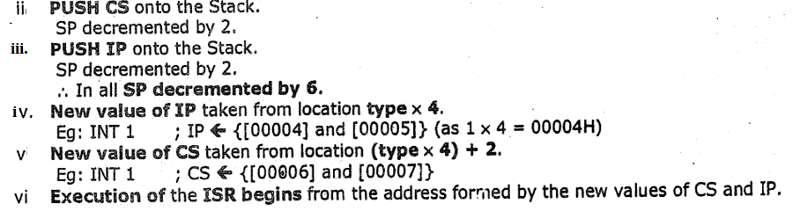
Interrupt Control Instuctions

Slide 121


Interrupt Control Instuctions

Slide 123
String Instructions
Dr. Manju Khurana
Assistant Professor, CSED
TIET, Patiala
manju.khurana@thapar.edu

Slide 124


String Instructions

Slide 125


String Instructions

Slide 126

String Instructions

Slide 127

String Instructions

Slide 128

String Instructions

Slide 129

String Instructions

